Slide 1


SAVEETHA SCHOOL OF ENGINEERING
SAVEETHA INSTITUTE OF MEDICAL AND TECHNICAL SCIENCES
COURSE CODE:
CSA1580 CLOUD COMPUTING FOR BIG DATA ANLYTICS FOR CLOUD API
TOPIC:
Bus ticketing and payment system on an open cloud platform.
FACULTY NAME:Dr.Gnana Soundari
By,
Ch.Harish
192210724

Slide 2
Bus Ticketing and Payment System Design and Implementation
This document outlines the design and implementation process for a bus ticketing and payment system on an open cloud platform.
Problem Statement
Develop a user-friendly and scalable bus ticketing system that allows passengers to book bus tickets, make secure payments, and manage their bookings online.
Requirements Gathering
Identifying Specific Requirements:
User Registration & Login
Search for available bus routes and schedules
View seat availability
Book tickets (including selecting seats)
Secure payment processing (credit card, debit card, etc.)
Ticket cancellation and refund management
User account management (view booking history, update profiles)
Admin panel for managing bus routes, schedules, fares, and reports

Slide 3
Determine Necessary Features:
Real-time seat availability updates
Integration with payment gateways
Secure user data storage
Email/SMS notifications for booking confirmations and updates
Responsive design for mobile access
Accessibility features for users with disabilities
Choosing a Cloud Provider
Popular options include:
Amazon Web Services (AWS): Offers a wide range of cloud services like EC2 for compute, S3 for storage, and DynamoDB for NoSQL databases.
Google Cloud Platform (GCP): Provides similar services with strengths in data analytics and machine learning.

Slide 4
Selection Criteria:
Scalability: Ability to handle increasing user traffic and data volume.
Security: Robust security measures to protect user data and financial transactions.
Cost: Pricing structure that fits the project budget.
Ease of Use: User-friendly interface for deployment and management.
Recommendation: Both AWS and GCP are strong contenders. Consider factors like existing infrastructure and developer familiarity to make the final decision.
Develop Frontend
Layout:
Clean and intuitive interface
Clear navigation for easy access to features
Responsive design for optimal viewing across devices
User-Friendly:
Simple and clear instructions
Error handling with informative messages
Accessibility features (screen reader compatibility, high-contrast themes)

Slide 5
Develop Backend
Database Implementation:
Consider a relational database like MySQL or PostgreSQL for user accounts, bookings, and bus information.
Utilize a NoSQL database like DynamoDB (AWS) or Cloud Firestore (GCP) for real-time updates on seat availability.
Execution:
Choose a programming language like Python or Java with a suitable web framework (Django, Spring) for backend development.
Implement RESTful APIs to handle communication between the frontend and backend.
Performance Evaluation
Monitor application performance metrics like response time, uptime, and resource utilization.
Conduct load testing to simulate real-world user traffic and identify potential bottlenecks.
Continuously optimize the application for scalability and efficiency.

Slide 6
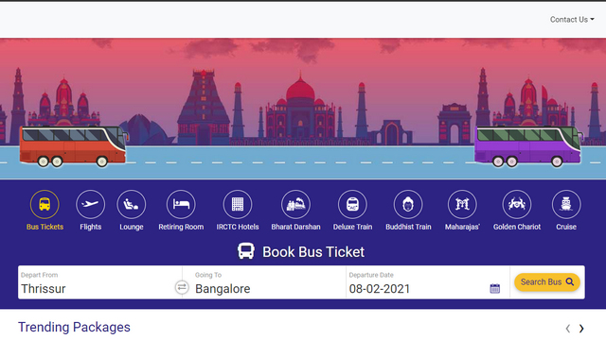

Slide 7
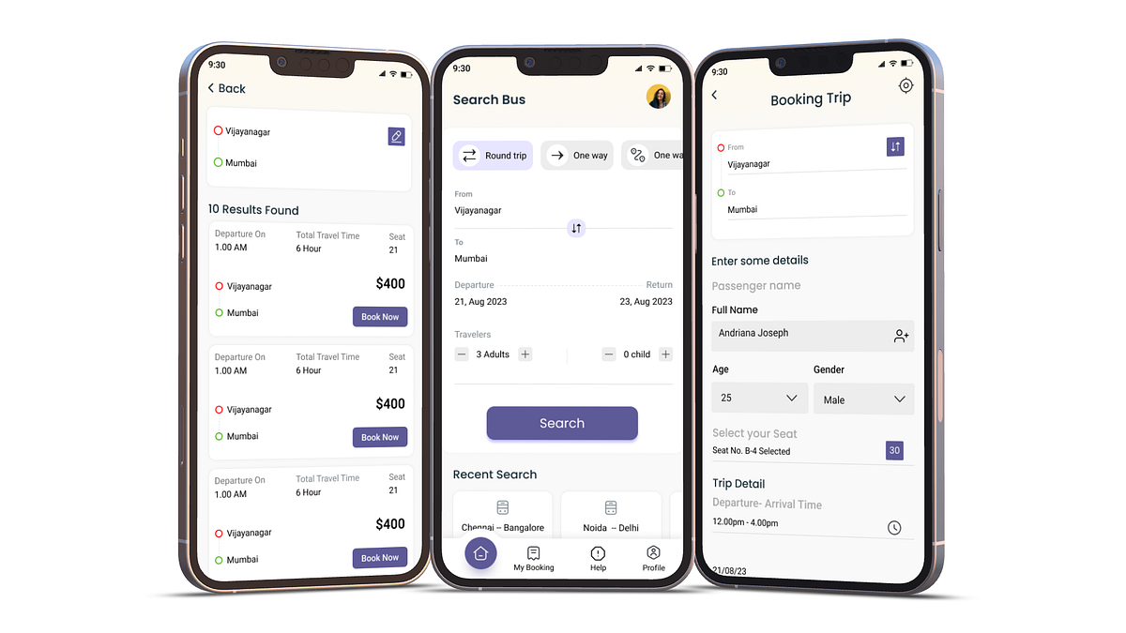

Slide 8
Implementation and Integration with Cloud Services
Implementation:
Develop the application based on the chosen technologies and architectural design.
Implement security measures like user authentication, data encryption, and secure coding practices.
Cloud Integration and Deployment:
Follow the cloud provider's documentation to deploy the application on the chosen platform.
Utilize cloud services for secure data storage, scalability, and automated processes.
Testing:
Perform thorough unit testing, integration testing, and user acceptance testing to ensure functionality and performance
Conclusion
By following these steps, you can develop and implement a robust, secure, and user-friendly bus ticketing and payment system on an open cloud platform. Remember to choose the appropriate technology stack and cloud provider based on your specific needs and resources.

Slide 9

THANK YOU

